Slide 1

Geopod: Geosciences Probe of Discovery

Slide 2

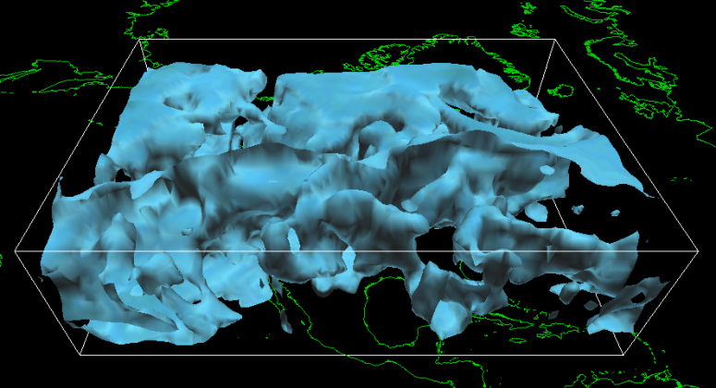
The Geopod Project
NSF Grant
Advanced Learning Technologies
Millersville CS & ES departments
Purpose
Create learning tool for meteorology students
Extend existing application: IDV
Make accessible & user friendly
Structure
Desktop Application
Web-based Mission Builder

Slide 3
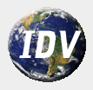
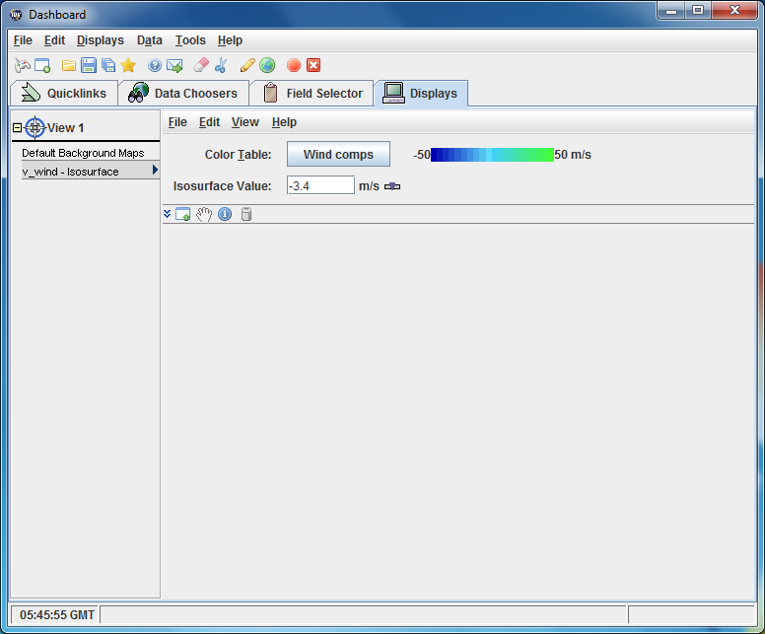
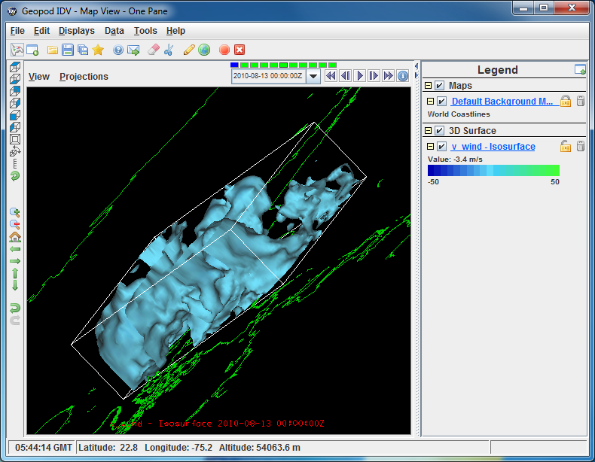
Integrated Data Viewer
Geosciences data visualization tool
Gold standard in meteorology
Wide range of functionality
Complex interface
Intended for advanced users

Slide 4
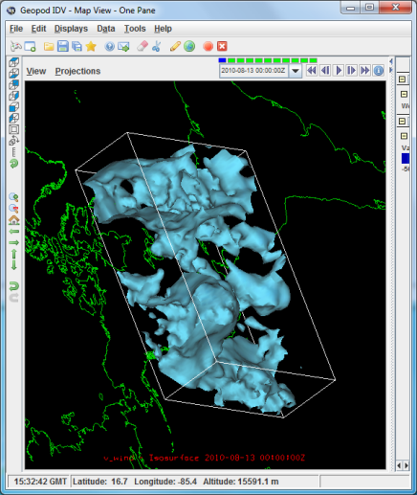
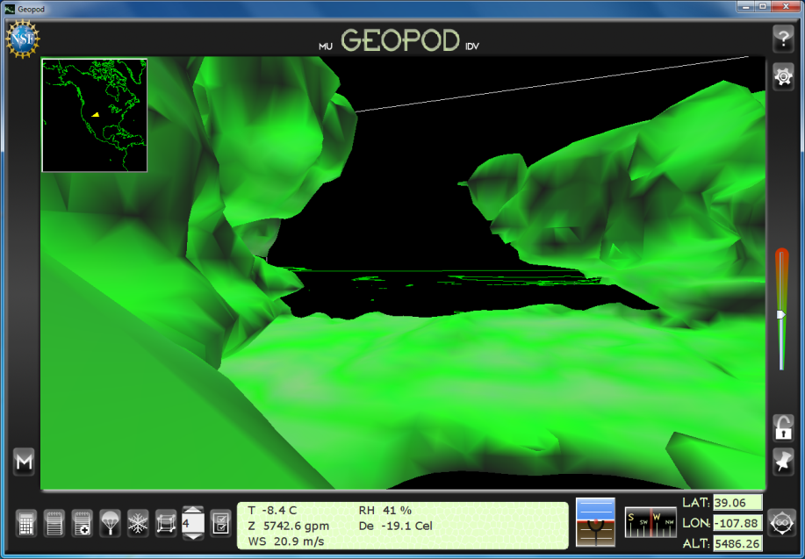
The Geopod Plugin
Student friendly, encourages learning
Interface
Simple design, no hidden functionality
First-person perspective
‘video game’ interaction
Viewing isosurfaces
Sampling parameters
Leverages IDV

Slide 5
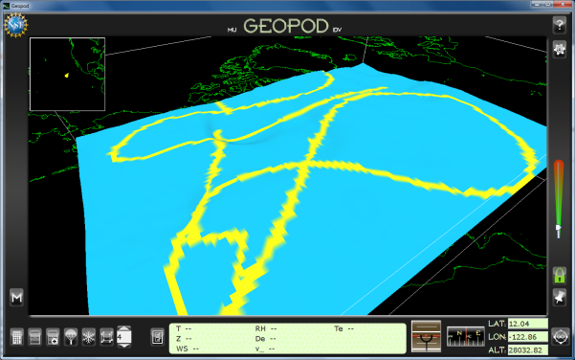
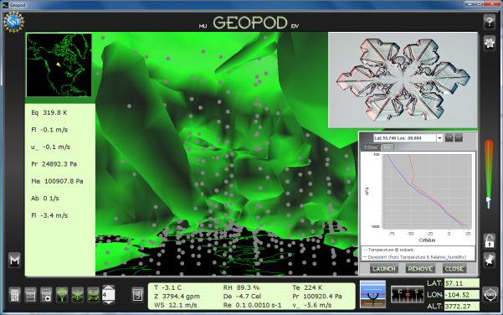
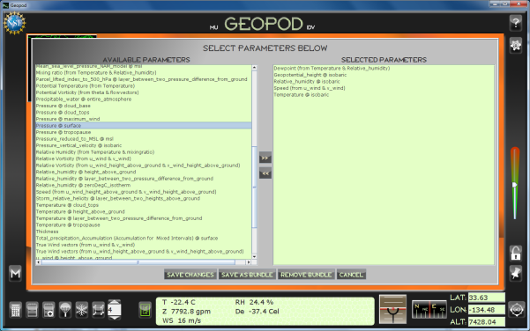
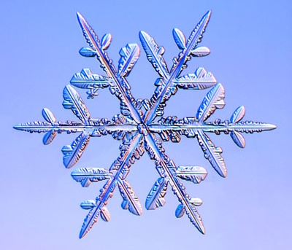
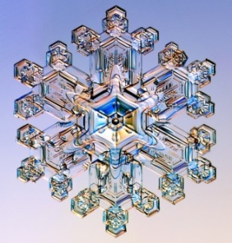
Geopod Features
Major Systems
Navigational tools
Dropsonde launcher
Particle imager
Isosurface lock
Geocoding
What I did
Note location & Notepad systems
Flight logging and playback
Mission system
Interface design
Testing

Slide 6
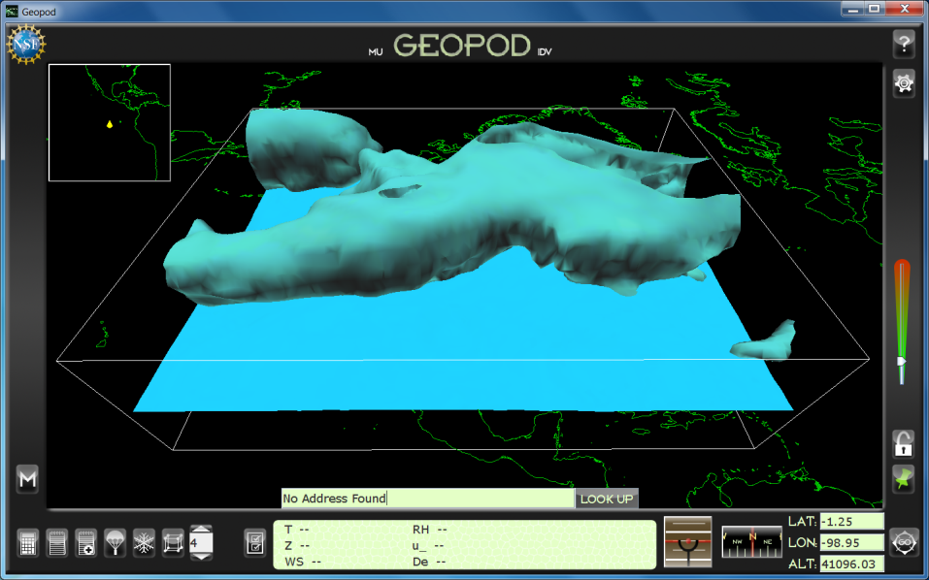
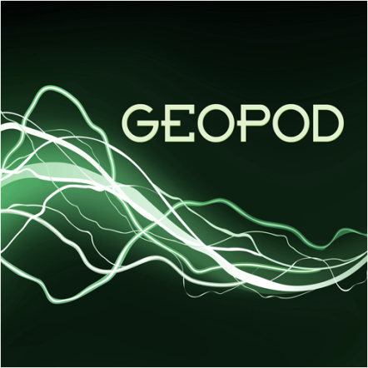
Preparing to use Geopod
Usability Study
Manuals
Training Sessions
Used in 4 meteorology classes
241, 341, 441, 444

Slide 7
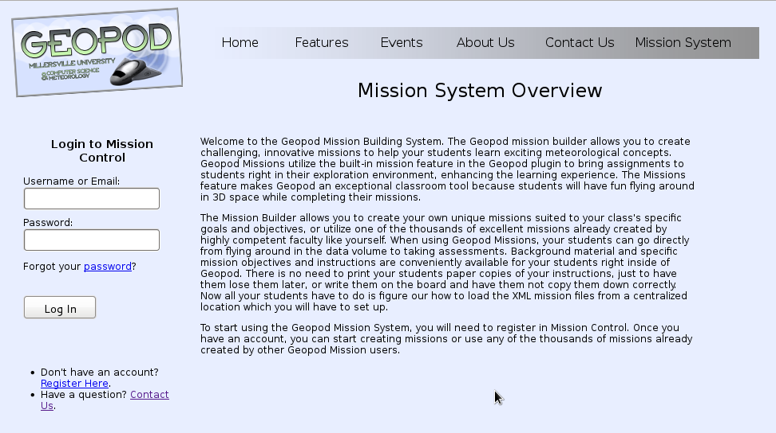
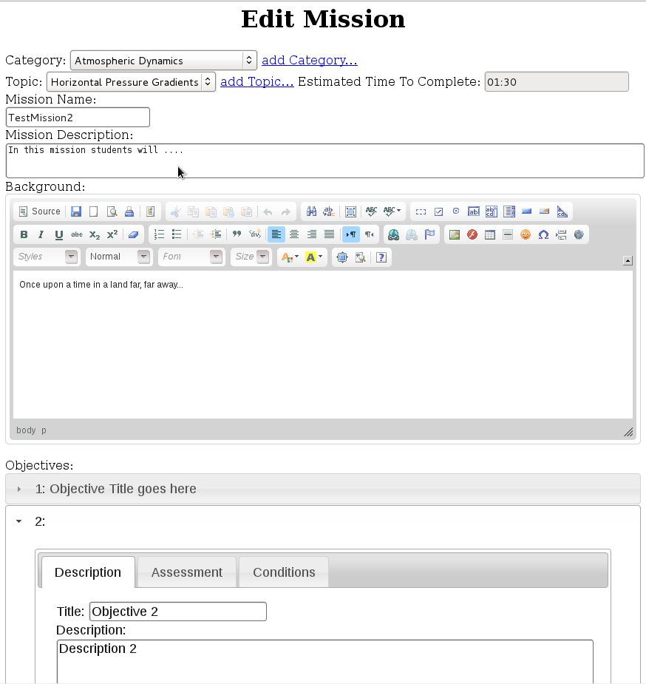
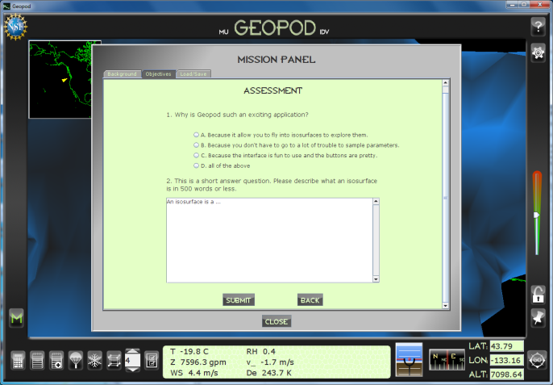
The Mission System
Mission
Lesson material
Multiple Objectives
Assessment
Online mission builder
Database of missions
Integrated with Geopod
Application
Work in progress

Slide 8

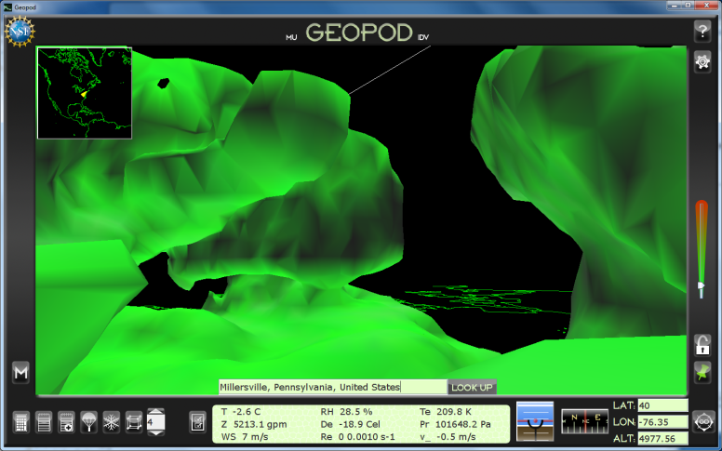
Benefits
Learned new technologies
Java3D, Swing, Javascript, jQuery, HTML, PHP, SQL…
Worked on a large project
Experienced SW development process
Applied skills from other courses
Human-Computer Interaction
Usability Study
Programming Sequence
Software Engineering
Tech Writing
Communication

Slide 9
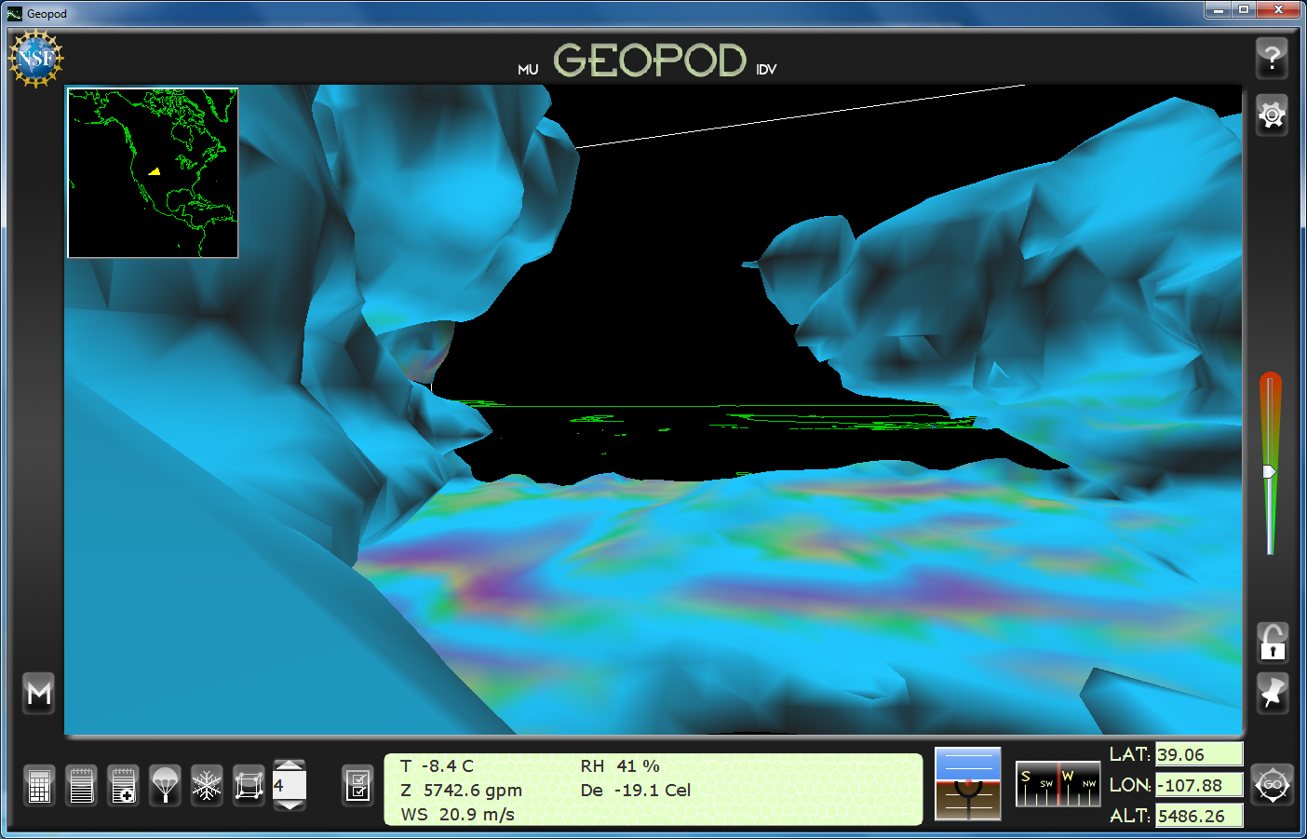
Questions?

